Slide 1
Deep Learning： 用Python進行深度學習的基礎理論實作
CH3 神經網路
Professor: Lu-Hung Chen
Presenter:Chih-Huan Wang

Slide 2
神經網路的範例
中間層
輸入層
輸出層

Slide 3




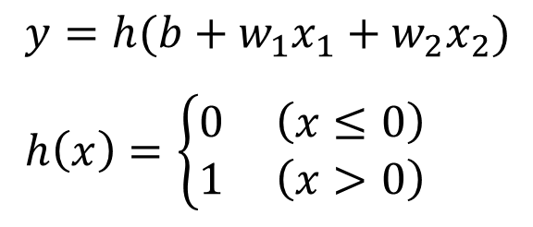



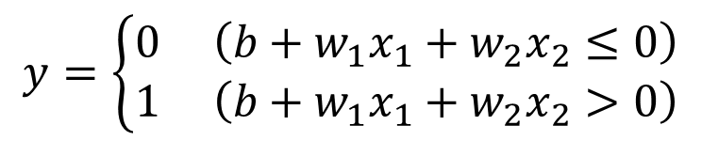




感知器
$y=h(b+w_{1}x_{1}+w_{2}x_{2})$
$h\left(x\right)=\left\{\begin{aligned}0 \left(x≤0\right) \\ 1 \left(x>0\right)\end{aligned}\right.$
$$y=\left\{\begin{aligned}0 \left(b+w_{1}x_{1}+w_{2}x_{2}≤0\right) \\ 1 \left(b+w_{1}x_{1}+w_{2}x_{2}>0\right)\end{aligned}\right.$$
$${ x}_{1}$$
1
$$w_{1}$$
$$b$$
$$y$$
$$w_{2}$$
$${ x}_{2}$$
$${ x}_{1}$$
$$w_{1}$$
$$y$$
$$w_{2}$$
$${ x}_{2}$$

Slide 4

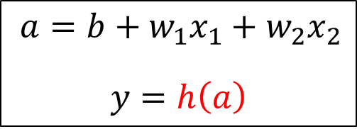








活化函數($activation function$)
1
$$b$$
$a=b+w_{1}x_{1}+w_{2}x_{2}$
$$y=h\left(a\right)$$
$$h\left( \right)$$
$${ x}_{1}$$
$$w_{1}$$
$$a$$
$$y$$
$$w_{2}$$
$${ x}_{2}$$

Slide 5
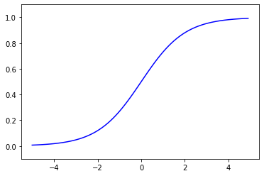
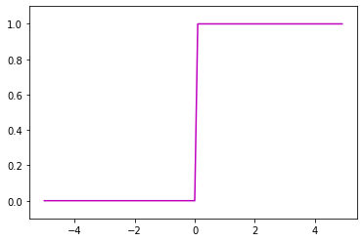
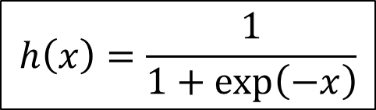


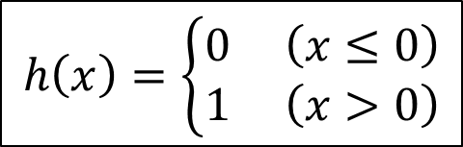
$$Sigmoid function$$
$$Step function$$
$$h\left(x\right)=\frac{1}{1+\exp\left(−x\right)}$$
$$h\left(x\right)=\left\{\begin{aligned}0 \left(x≤0\right) \\ 1 \left(x>0\right)\end{aligned}\right.$$

Slide 6
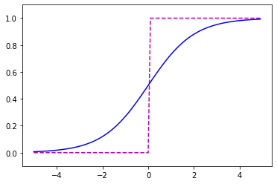

比較
為何使用非線性?
平滑度的差異
輸出訊號介在0~1之間
皆為非線性函數
若
$h\left(x\right)=cx$
$y=h\left(h\left(h\left(x\right)\right)\right)$
$⇒y=c^{3}x$

Slide 7
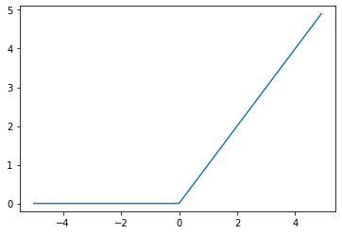

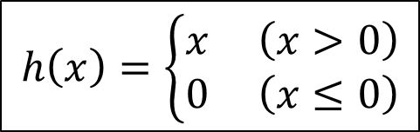
$ReLU\left(Rectified Linear Unit\right)$函數
$$h\left(x\right)=\left\{\begin{aligned}x \left(x>0\right) \\ 0 \left(x≤0\right)\end{aligned}\right.$$

Slide 8
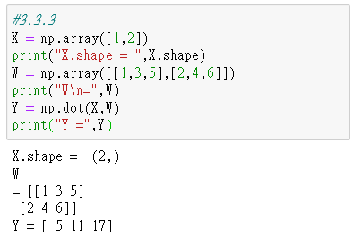
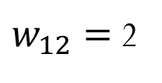

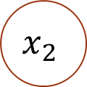
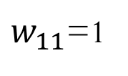



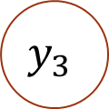




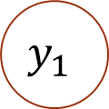


神經網路的乘積
$$\left(\begin{matrix}x_{1} & x_{2}\end{matrix}\right)$$
$$\left(\begin{matrix}1 & 3 & 5 \\ 2 & 4 & 6\end{matrix}\right)$$
$$\left(\begin{matrix}y_{1} & y_{2}\end{matrix}\right)$$
$w_{11}$=1
$$y_{1}$$
X W ＝ Y
$$2$$
$$2×3$$
$$3$$
$$x_{1}$$
$w_{12}=$2
$$\left(1×2\right)$$
$$\left(1×3\right)$$
3
$$y_{2}$$
4
$$x_{2}$$
5
$$y_{3}$$
6

Slide 9
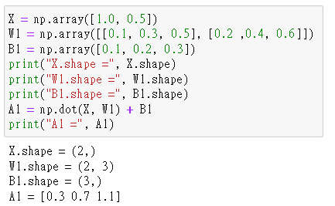




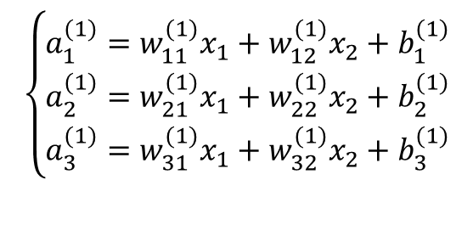







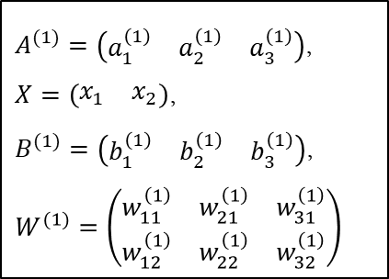
三層神經網路
$$b_{1}^{\left(1\right)}$$
1
$$a_{1}^{\left(1\right)}$$
$$w_{11}^{\left(1\right)}$$
$$y_{1}$$
$$x_{1}$$
$$w_{12}^{\left(1\right)}$$
$$a_{2}^{\left(1\right)}$$
$$x_{2}$$
$$y_{2}$$
$$a_{3}^{\left(1\right)}$$
$$\left\{\begin{matrix}a_{1}^{(1)}=w_{11}^{(1)}x_{1}+w_{12}^{(1)}x_{2}+b_{1}^{(1)} \\ a_{2}^{(1)}=w_{21}^{(1)}x_{1}+w_{22}^{(1)}x_{2}+b_{2}^{(1)} \\ a_{3}^{(1)}=w_{31}^{(1)}x_{1}+w_{32}^{(1)}x_{2}+b_{3}^{(1)}\end{matrix}\right.$$
$A^{(1)}=\left(\begin{matrix}a_{1}^{\left(1\right)} & a_{2}^{\left(1\right)} & a_{3}^{\left(1\right)}\end{matrix}\right)$,
$X=\left(\begin{matrix}x_{1} & x_{2}\end{matrix}\right)$,
$B^{(1)}=\left(\begin{matrix}b_{1}^{\left(1\right)} & b_{2}^{\left(1\right)} & b_{3}^{\left(1\right)}\end{matrix}\right)$,
$W^{(1)}=\left(\begin{matrix}w_{11}^{\left(1\right)} & w_{21}^{\left(1\right)} & w_{31}^{\left(1\right)} \\ w_{12}^{\left(1\right)} & w_{22}^{\left(1\right)} & w_{32}^{\left(1\right)}\end{matrix}\right)$
$$A^{(1)}=XW^{(1)}+B^{(1)}$$

Slide 10
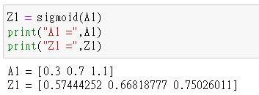
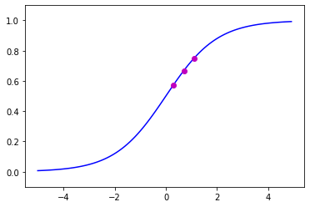
















三層神經網路
1
1
$$b_{1}^{\left(1\right)}$$
$$h\left( \right)$$
1
$$a_{1}^{\left(1\right)}$$
$$z_{1}^{\left(1\right)}$$
$$w_{11}^{\left(1\right)}$$
$$y_{1}$$
$$x_{1}$$
$$h\left( \right)$$
$$w_{12}^{\left(1\right)}$$
$$a_{2}^{\left(1\right)}$$
$$z_{2}^{\left(1\right)}$$
$$x_{2}$$
$$y_{2}$$
$$h\left( \right)$$
$$a_{3}^{\left(1\right)}$$
$$z_{3}^{\left(1\right)}$$

Slide 11
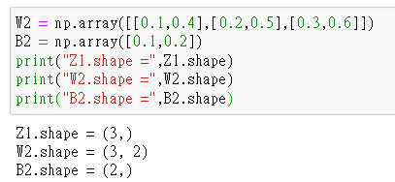
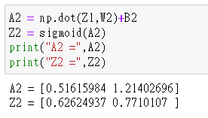
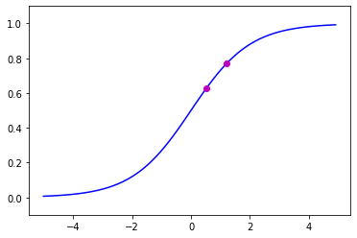

















三層神經網路
1
$$b_{1}^{\left(2\right)}$$
1
$$h\left( \right)$$
1
$$a_{1}^{\left(1\right)}$$
$$z_{1}^{\left(1\right)}$$
$$w_{11}^{\left(2\right)}$$
$$h\left( \right)$$
$$a_{1}^{\left(2\right)}$$
$$z_{1}^{\left(2\right)}$$
$$y_{1}$$
$$w_{12}^{\left(2\right)}$$
$$x_{1}$$
$$h\left( \right)$$
$$a_{2}^{\left(1\right)}$$
$$z_{2}^{\left(1\right)}$$
$$w_{13}^{\left(2\right)}$$
$$h\left( \right)$$
$$x_{2}$$
$$a_{2}^{\left(2\right)}$$
$$z_{2}^{\left(2\right)}$$
$$y_{2}$$
$$h\left( \right)$$
$$a_{3}^{\left(1\right)}$$
$$z_{3}^{\left(1\right)}$$

Slide 12
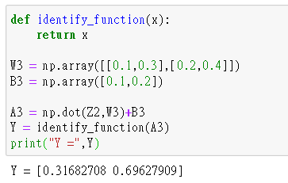
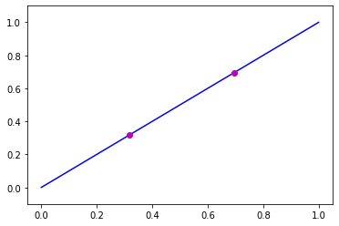












三層神經網路
輸出層使用的活化函數
迴歸問題
1
$$b_{1}^{\left(3\right)}$$
恆等函數
$$w_{11}^{\left(3\right)}$$
$$σ\left( \right)$$
$$z_{1}^{\left(2\right)}$$
$$a_{1}^{\left(3\right)}$$
$$y_{1}$$
二分類問題
$$w_{12}^{\left(3\right)}$$
$$Identity function$$
$$σ\left( \right)$$
sigmoid函數
$$z_{2}^{\left(2\right)}$$
$$a_{2}^{\left(3\right)}$$
$$y_{2}$$
多分類問題
softmax函數

Slide 13
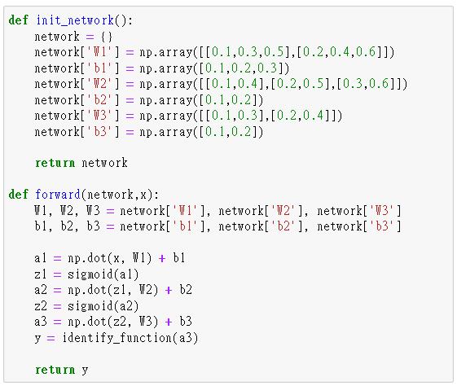
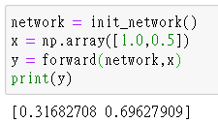
三層神經網路

Slide 14
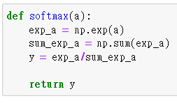
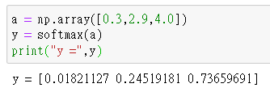
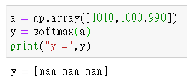


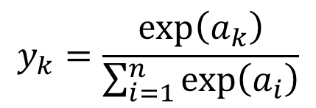






$Softmax function$
$$y_{k}=\frac{\exp\left(a_{k}\right)}{\sum_{i=1}^{n}{\exp\left(a_{i}\right)}}$$
$$σ\left( \right)$$
優點：
輸出為0~1.0之間的實數
可用來解讀為機率
各元素的大小關係不變
$$a_{1}$$
$$y_{1}$$
$$a_{2}$$
$$y_{2}$$
$$a_{3}$$
$$y_{3}$$

Slide 15
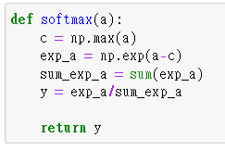
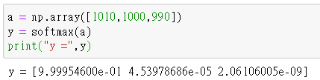
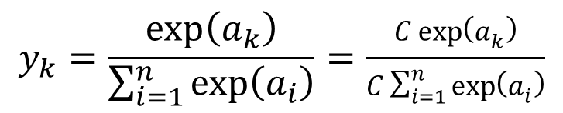

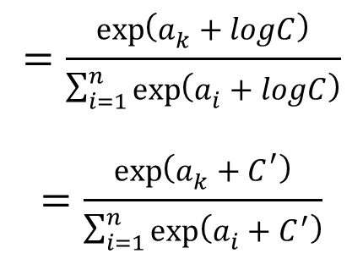
$Softmax function$(優化)
$$y_{k}=\frac{\exp\left(a_{k}\right)}{\sum_{i=1}^{n}{\exp\left(a_{i}\right)}}=\frac{C\exp\left(a_{k}\right)}{C\sum_{i=1}^{n}{\exp\left(a_{i}\right)}}$$
$$=\frac{\exp\left(a_{k}+logC\right)}{\sum_{i=1}^{n}{\exp\left(a_{i}+logC\right)}}$$
$$=\frac{\exp\left(a_{k}+C^{′}\right)}{\sum_{i=1}^{n}{\exp\left(a_{i}+C^{′}\right)}}$$

Slide 16









輸出層的神經元數量
$$y_{0}$$
$$=「0」$$
$$y_{1}$$
$$=「1」$$
某種運算
$$y_{2}$$
$$=「2」$$
…
…
$$y_{9}$$
$$=「9」$$

Slide 17
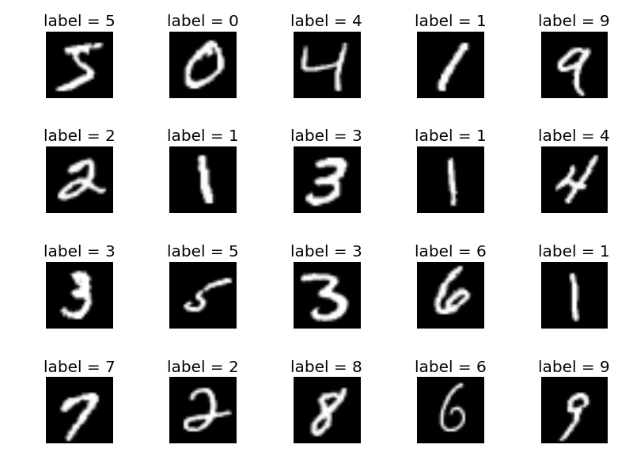
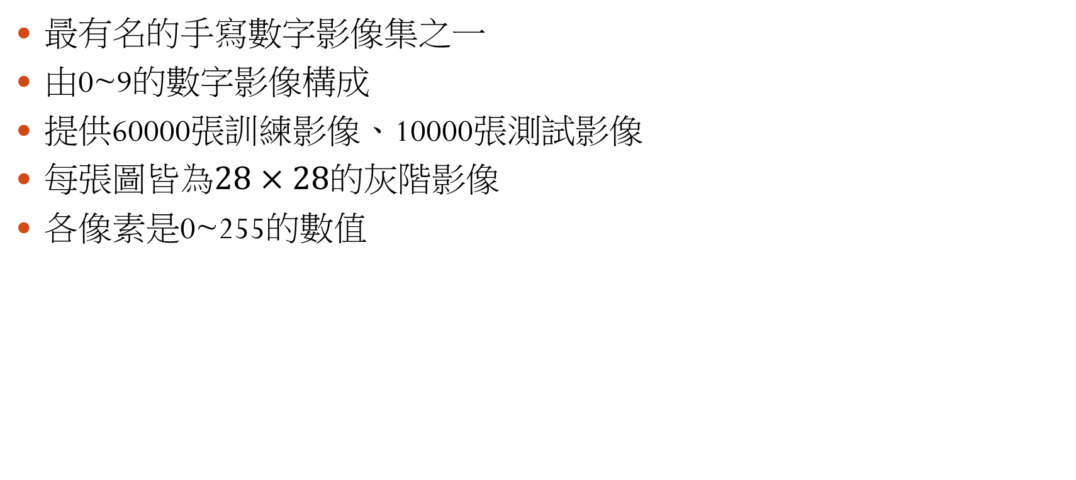
MNIST 資料集
最有名的手寫數字影像集之一
由0~9的數字影像構成
提供60000張訓練影像、10000張測試影像
$每張圖皆為28×28的灰階影像$
各像素是0~255的數值

Slide 18
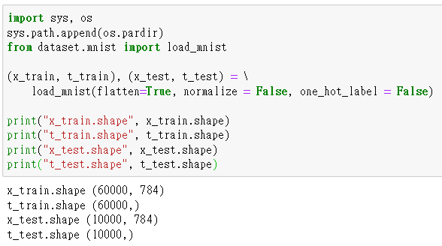





載入MNIST資料集
父目錄
$$os.pardir$$
Ch3(資料夾)
dataset(資料夾)
$$Ch3.ipynb$$
$$mnist.py$$
True
$$[0,0,0,0,0,1,0,0,0,0]$$
False
$$5$$

Slide 19
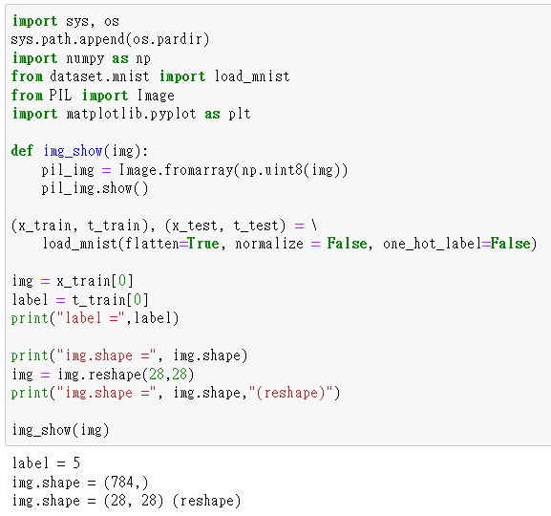
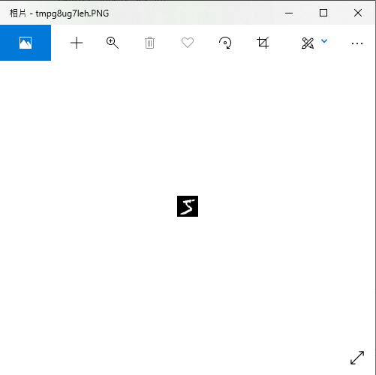
載入圖片

Slide 20
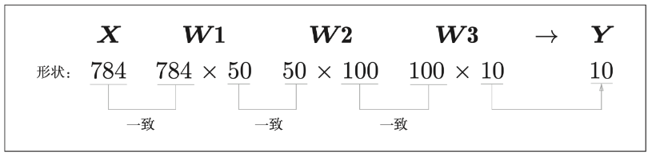
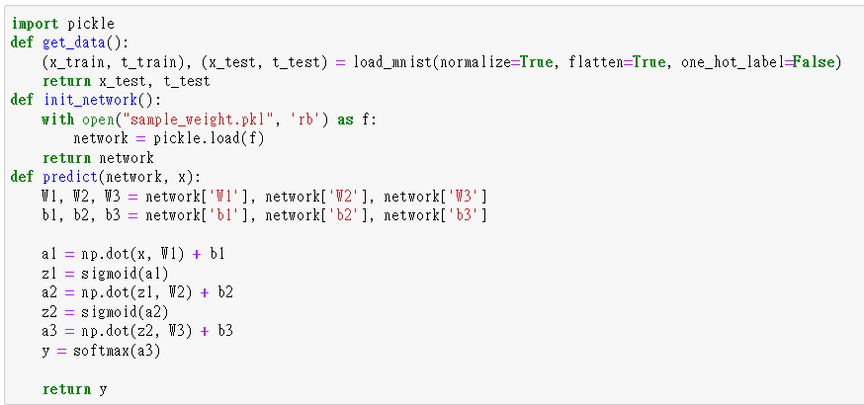
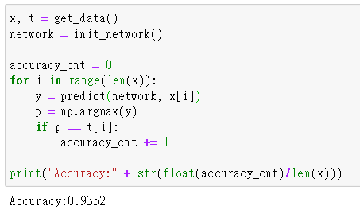
推論處理

Slide 21


批次處理

